Slide 1

Stats for Ansible implementation: Alibaba Vs AWS Vs Baidu Vs Huawei Vs JDCloud Vs Tencent Vs U Cloud
Column 1 – Total Cloud Services
Column 2 - Total APIs Available for developers
Column 3 - Ansible Available for developers
Chart Analysis:
The API required for Baidu are more as compare to AWS, Alibaba and Huawei
Baidu still need to develop 737(737-0) Workbench calls (Interfaces)
Baidu is lagging to provide 737( 737-0) Ansible Implementation in market
Alibaba with 37 and AWS with 349 Ansible Implementation is way ahead of the Baidu’s 0
Baidu has converted 0% of their Workbench call (interfaces) in to Ansible as compared with Alibaba which is 4% and AWS which is 20%
Minimum scope in current phase = Ansible Implementation for 737 (737-0) Workbench calls (interfaces)

Slide 2
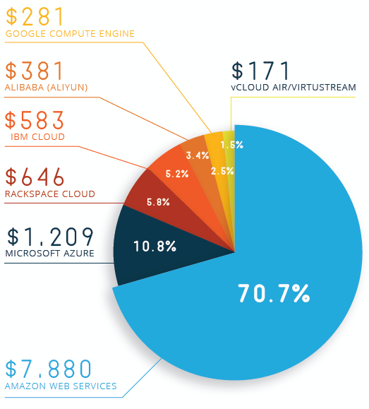


Market Size of Cloud for IaaS, PaaS and SaaS (2015-2018)
PaaS Market Stats
All values are in Million Dollar
Current (2015) and expected (2018) market size for cloud business
Growth Expected in coming three years
Source: Massive-Scale Cloud, April 30, 2016, Structure Research
Red Hat ISV
and Advanced Partner
Click2Cloud Inc.
© 2017 – For Internal Use Only

Slide 3
Stats for Ansible implementation: Alibaba Vs AWS Vs Baidu Vs Huawei Vs JDCloud Vs Tencent Vs U Cloud
Column 1 – Total Cloud Services
Column 2 - Total APIs Available for developers
Column 3 - Ansible Available for developers
Chart Analysis:
The API required for Baidu are more as compare to AWS, Alibaba and Huawei
Baidu still need to develop 737(737-0) Workbench calls (Interfaces)
Baidu is lagging to provide 737( 737-0) Ansible Implementation in market
Alibaba with 37 and AWS with 349 Ansible Implementation is way ahead of the Baidu’s 0
Baidu has converted 0% of their Workbench call (interfaces) in to Ansible as compared with Alibaba which is 4% and AWS which is 20%
Minimum scope in current phase = Ansible Implementation for 737 (737-0) Workbench calls (interfaces)

Slide 4
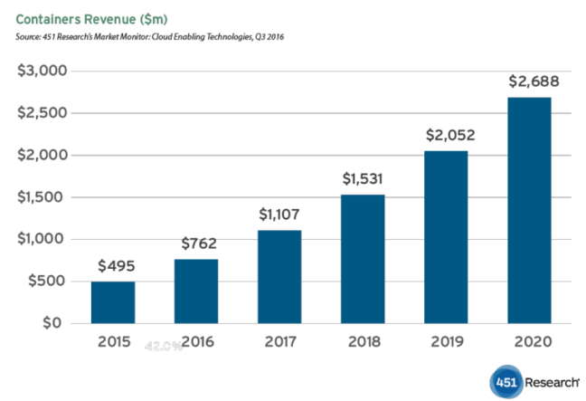
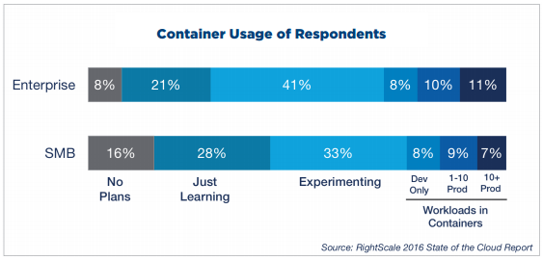
Containers Revenue ($m) by Docker
Container Adoption Stats
Ref: https://cote.io/2017/04/22/the-news-from-docker-land-plus-the-money-being-fought-over-notebook/
Ref: https://www.coscale.com/blog/docker-usage-statistics-increased-adoption-by-enterprises-and-for-production-use
Red Hat ISV
and Advanced Partner
Click2Cloud Inc.
© 2017 – For Internal Use Only

